Slide 1
PROJECT TITLE TRACK WORKPLACE CONDITION TO ENSURE EMPLOYEE SAFETY IN WAREHOUSE

Slide 2
Index:
1. Project Introduction
2. Technical Architecture
3. Problem Statement
4. Problem solution
5. Output Window
6. Conclusion

Slide 3
Project Introduction
Safety is a critical consideration for any welding project. Arc welding is a safe occupation when proper precautions are taken. But, if safety measures are ignored, welders face an array of hazards that can be potentially dangerous, including electric shock, fumes and gases, fire and explosions, and more. It is essential that all welders wear the necessary safety equipment(helmets, safety goggles, Fire/Flame resistant clothing and aprons, and gloves) at all times. Wearing helmets and shoes in the warehouse are intended to help protect users from sudden draw drops of any material in the warehouse that strike directly against the helmet. There have been countless stories of workers being saved by helmets. This project aims at building a visual recognition model that can detect whether a person is wearing safety equipment or not using a model built with visual recognition service.

Slide 4
Problem Statement:
Based on accident statistics alone, warehouse work is risky work. It is the employer’s duty to draw instructions and rules and follow them.
There have been several cases of deaths and injuries to the employees in the warehouse while working without following or using the required equipment’s like not wearing helmet etc.
The aim of this project is to make the workers strictly follow the rules wile working the warehouse

Slide 5
Problem solution
In this project, we will be developing a model which will help in tracking the safety of employees in the warehouse.
We will be training and the testing the model using datasets making sure the accuracy of predicting is high .
We will be using live camera , in which the camera will process the employee and allow him/her inside only if they are wearing the required equipment’s.
By doing so, we will be able to track the safety of employees and also reduce the risk of employees getting injured, as they will only be allowed into the workspace only if they are wearing the required equipment’s.

Slide 6
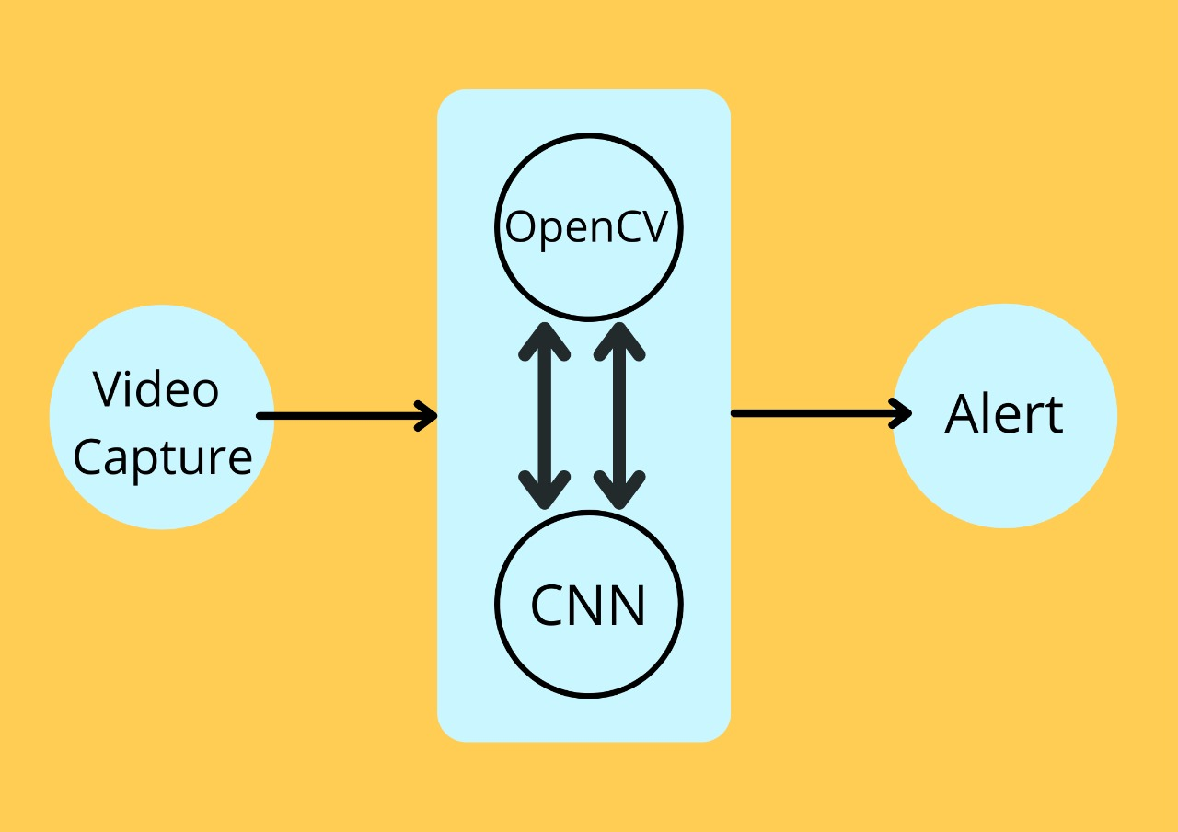
Technical Architecture :

Slide 7
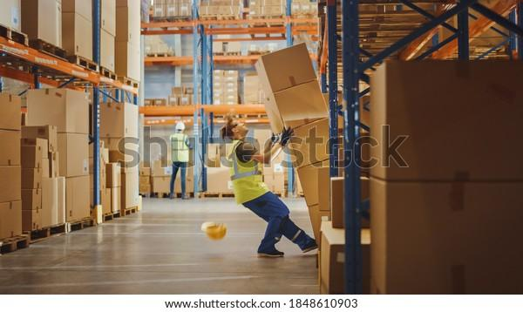
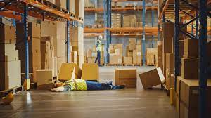
.

Slide 8

.

Slide 9
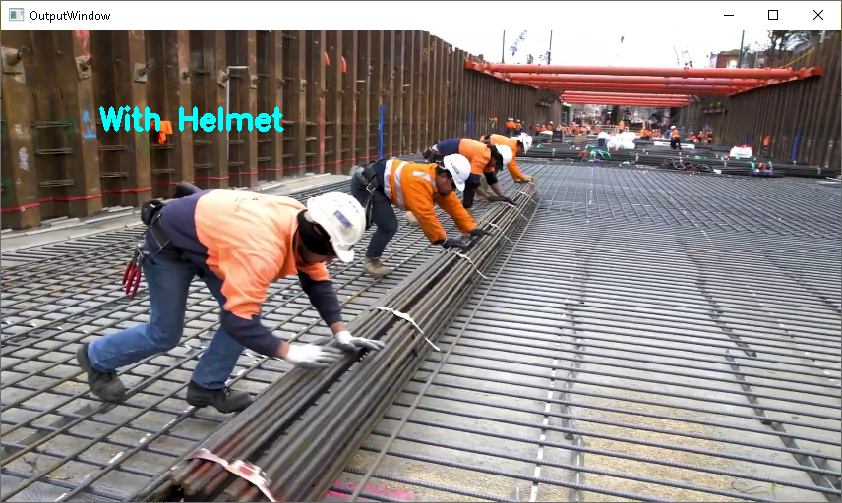
Output window:

Slide 10
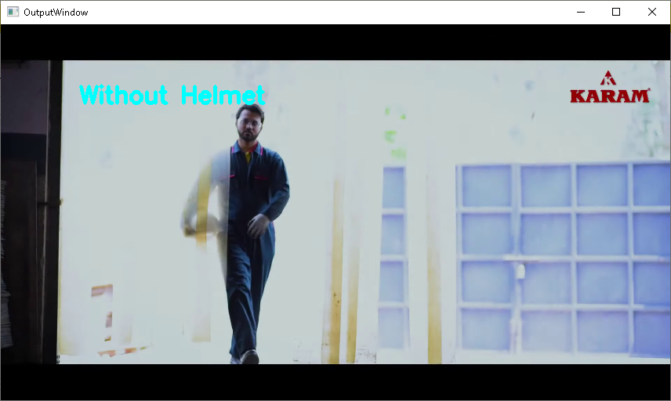
Output window:

Slide 11
Conclusion:
So, by developing this model we will able to track the safety and also reduce the risk of employees getting hurt in the warehouse.
A dataset of 180 images containing various helmets is built and divided into two parts to train and test the model.
The Tensor Flow framework is chosen to train the model.
After the training and testing process, the helmet detection model is built.
The experiment results demonstrate that the method can be used to detect the safety helmets worn by the warehouse workers at the warehouses and storage facilities.
The presented method offers an alternative solution to detect the safety helmets and improve the safety management of the workers at the warehouse facilities.

Slide 12
Group members :
Satish Kona 18481A0246
Tagore Rao Kosireddy 18481A0248
Vijay Kumar Kommu 18481A0245
Yedukondala Naga Sai Vinay Kotari 18481A0250
Vijay Babu Kowju 18481A0252

Slide 13
THANK YOU !

